Slide 1




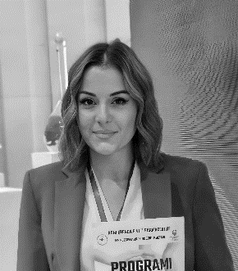
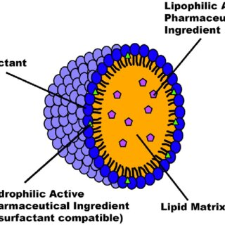

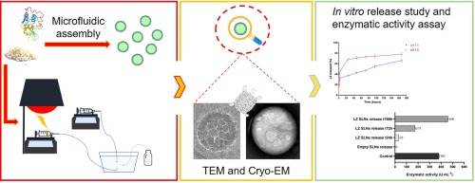
ADVANCED DRUG DELIVERY SYSTEMS
Contact person/Group leader:
Prof. Nunzio DENORA
Affiliation
Department of Pharmacy – Pharmaceutical Sciences, University of Bari Aldo Moro
Mail address
University Campus - Street ‘’E. Orabona’’, 4, Bari Italy
Email/website
nunzio.denora@uniba.it
https://persone.ict.uniba.it/rubrica/nunzio.denora
Group Members
Prof. Ass. Silvi Bozo
Google Scholar
https://scholar.google.com/citations?user=Ai2Bx60AAAAJ&hl=it
Research Gate
https://www.researchgate.net/profile/Nunzio-Denora
Research lines
Innovative nano-drug delivery systems
Microfluidic techniques for the production of advanced nano drug delivery systems
Direct powder extrusion 3D printing of nanomaterials
Targeted nanocarriers for the selective delivery of therapeutics and diagnostics to pathological disorders.

